Slide 1
Vertebrates

Slide 2
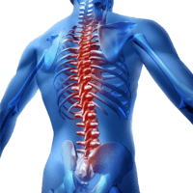
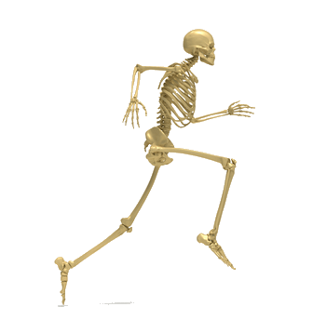
What's so special about a backbone?
Run your fingers down your back and you can feel your own backbone. It protects your spinal cord, a long nerve that connects your brain to the rest of your body.
It also supports the rest of your skeleton, so you can move and feed yourself. How's that for important?

Slide 3

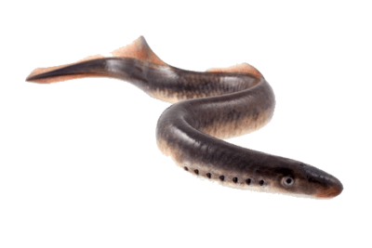
Agnatha (means "without jaws")
Agnatha are jawless fish. Today there are only hagfish and lampreys that fit into this class, but we have found many fossils from prehistoric jawless fish.
All living agnatha are parasites, with a round mouth for sucking onto host organisms. Their skeletons are made of cartilage, not bone, which makes them very flexible. Lampreys can literally tie themselves into knots!

Slide 4

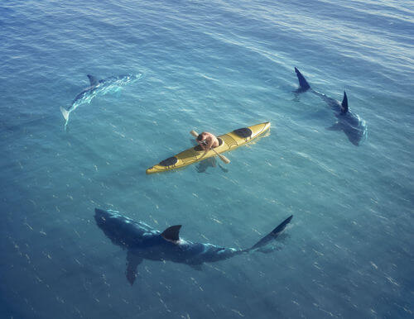
Chondrichthyes (means "cartilage fish," pronounced con-drik-thees)
Chondrichthyes have a skeleton made of cartilage, which is very flexible. Examples of chondrichthyes include sharks, rays and skates.
They have fully developed jaws and teeth for catching and eating other fish. They also have fins for swimming and gills for breathing under water.

Slide 5
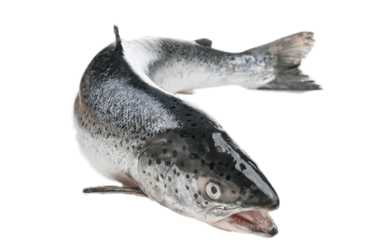
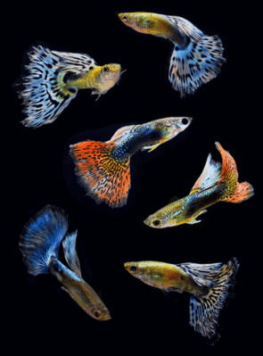
Osteichthyes (means "bony fish," pronounced ost-ee-ick-thees)
Another aquatic (water-living) group is called the osteichthyes. Common species of fish, such as tuna, salmon, eels and trout are examples of osteichthyes. They have a full skeleton made up of strong bone.

Slide 6
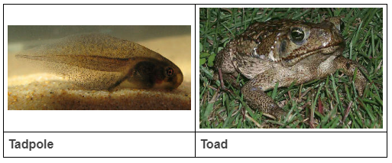
Amphibians
Animals that live in and out of water are called amphibians.
Amphibians begin their lives in water as tadpoles, equipped with gills and tails. As they grow, they develop lungs and legs in order to survive on land. This process of change is called metamorphosis.
Frogs, toads and salamanders are all examples of amphibians.

Slide 7
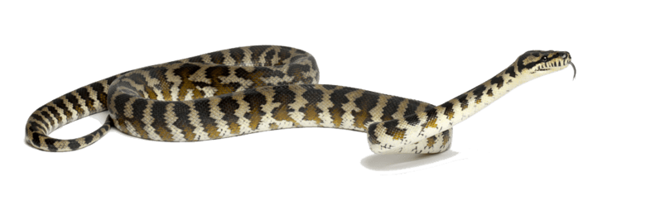
REPTILES
Snakes, lizards, turtles and crocodiles are all examples of reptiles.
Reptiles have bodies covered in scales and are cold-blooded. Being cold-blooded means that their bodies have the same temperature as their surroundings. When they get too hot, they can go into water or shade to cool off. They reproduce by laying eggs.

Slide 8
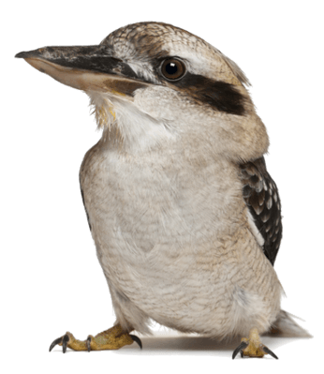
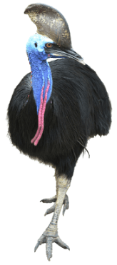
AVES (birds)
Aves include birds and their ancestors, which evolved from dinosaurs. All birds have feathers covering their body and lay eggs. Most of them also have wings and can fly through the air!
However some birds have lost their wings and cannot fly, like emus, cassowaries and penguins.

Slide 9
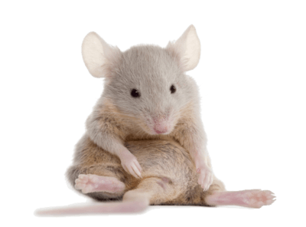
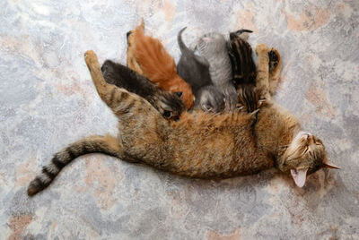
Mammals
The final class of chordates is the mammals. They include the tiniest mice and the biggest whales!
Mammals have a body covered in hair or fur. Their offspring feed on milk produced by their mothers. These kittens are drinking their mother's milk:

Slide 10


Slide 11
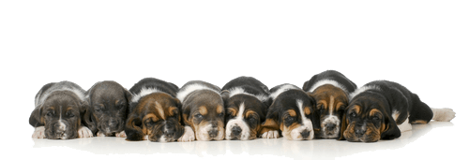
There are three subclasses of mammals - placentals, monotremes and marsupials - which are classified based on how they reproduce.
Placentals are mammals that develop within the mother's body. Humans, seals, cows and dogs are examples of placental mammals.

Slide 12
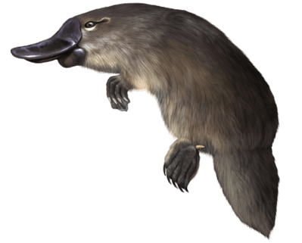
Monotremes are mammals that lay eggs, like reptiles.
Examples are the echidna and platypus, both found in Australia!

Slide 13
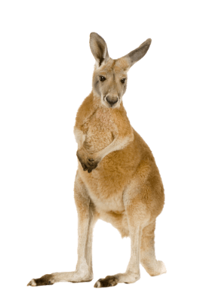
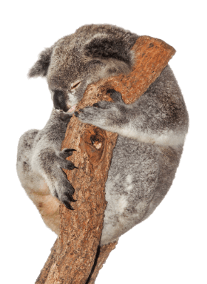
Marsupials, such as kangaroos, have offspring that live in a pouch where they feed on milk.
Australia is famous for its marsupials - the koala is another example.

